Slide 1
Movie Recommendations Using Text Mining
04/27/2023
1
#1

Slide 2
Hello! We are Group 7
Jenson Lahtinen​
Vijaya Lakshmi Nangineni​
Impana Srinivas​
Sarthak Bairiganjan​
Namaskrutha Ghanta

Slide 3
Background
Coming back from either work or school, it's a question that we've all encountered at least once: what movie or show should I watch tonight?
With so many movies and TV shows available, it can be difficult to decide what to watch.
Reviews are essential in helping people determine if a movie or show is worth their time.
We are using text mining techniques to analyze public opinion and determine the popularity of different movies and TV shows.
Our analysis enables us to identify what is highly regarded and currently being discussed by people online.
This helps viewers make more informed choices when selecting what to watch.

Slide 4
Scope of the project:
Movie recommendation systems can increase user engagement, satisfaction, and retention on streaming platforms.
By suggesting movies based on user preferences, these systems can encourage users to continue using the platform and potentially pay for a subscription.
If a user discovers a new movie through the recommendation system and decides to rent or purchase it, the platform can earn additional revenue from that transaction.

Slide 5
Objective
Our model is designed to track and analyze language used in comments, allowing us to determine whether feedback about a piece of media is positive or negative. This helps us to evaluate the overall appraisal of the media in question.
Any movie production company can use our system to evaluate the popularity of their films and develop effective marketing strategies based on the analysis.
Our model provides insights into the popularity of different movies and shows by tracking positive and negative feedback. This enables us to determine whether a particular media is gaining significant positive or negative traction.

Slide 6
We will talk about this first.
Data Collection
01
Size of dataset: The dataset includes 444 rows from r/MovieSuggestions, r/HBO, and r/AmazonPrimeVideo sub-reddits.
Data Source: The data was collected using Reddit’s API(praw) and stored in a csv dataset.
Format: CSV file with columns for CommentID, Author, Timestamp, Comment, replyto, CommentThreadID,ThreadTitle, MsgBody and Comment Permalink.
Add a brief introduction of your section here: Let’s dive in and get to know some interesting facts about animals!

Slide 7
Data Preprocessing
Data Cleaning: As a part of data preprocessing, the data was cleaned by removing noisy and irrelevant data.
Tokenization: Next, the posts were tokenized by splitting them into individual words while also removing stop words and punctuation using Spacy’s tokenizer.

Slide 8
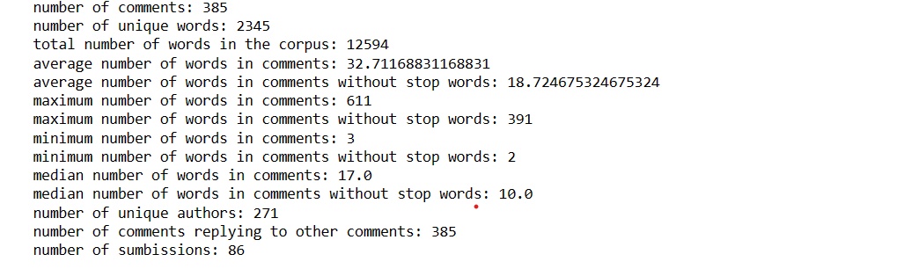
Data Preprocessing
Descriptive Statistics:

Slide 9
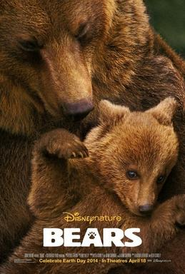


Did you know?
Topic Modelling
Topic modeling is a technique in the field of machine learning and natural language processing that is used to identify the underlying topics or themes within a given document
For the topic modeling we decided to use LDA to help determine positively and negatively charged comments in association with different movies, genres, and TV shows. This will help us determine what is currently being discussed and give insight into how the perception of the media is currently valued.
Did you know that a cat uses its whiskers as feelers to determine if a space is too small to squeeze through?
Also, cats love to sleep. A fifteen-year-old cat has probably spent ten years of its life sleeping.
Did you know that dogs can smell your feelings?
Dogs can pick up on subtle changes in your scent, which can you become nervous or fearful.
?

Slide 10
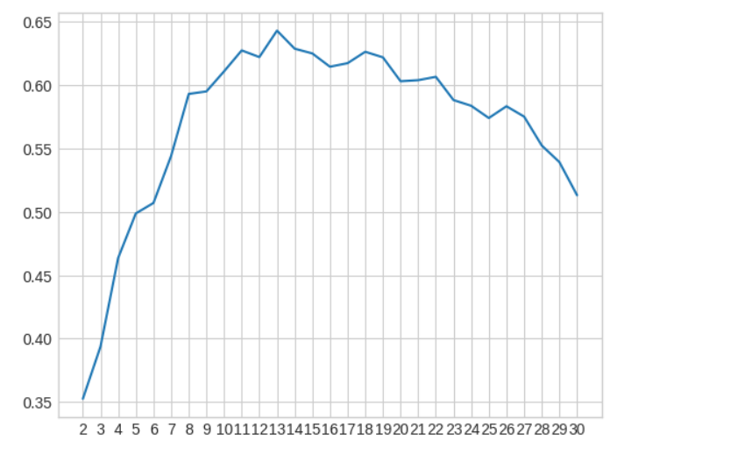
Identification of K Value
By examining the coherence chart on the left, we determined that the optimal value for k is 13. However, we conducted several trials using different values of k and found that a value of 7 resulted in the best clustering with minimal overlap between the clusters.

Slide 11
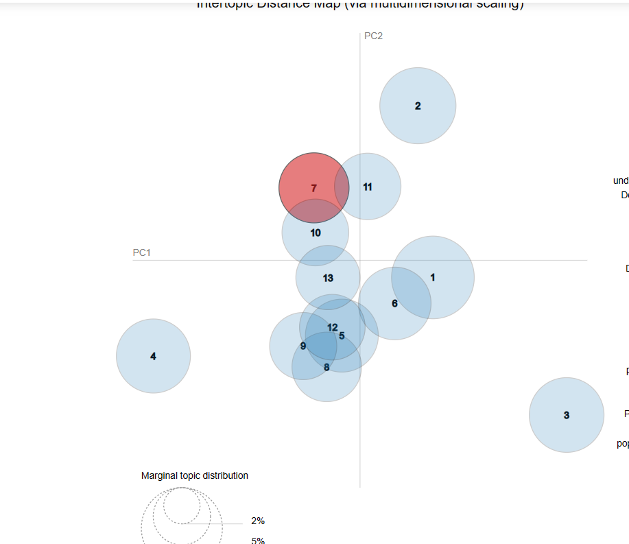
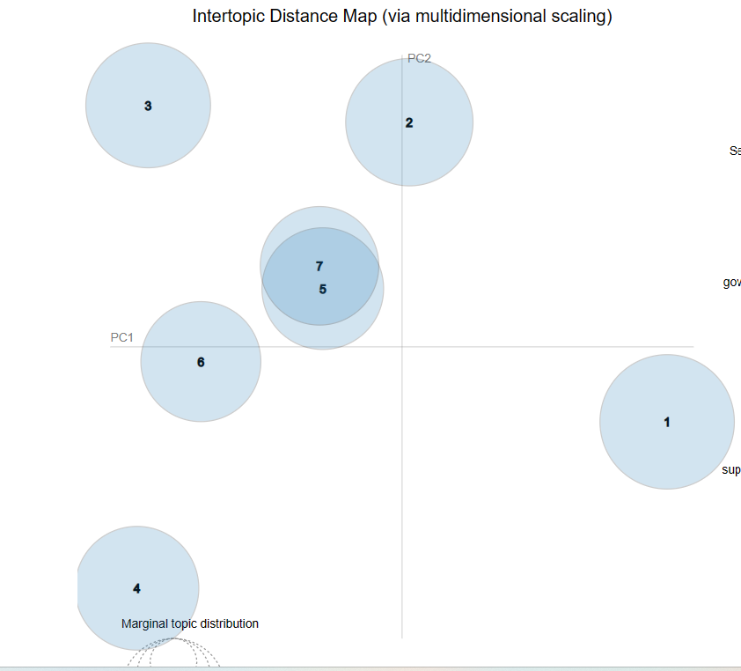
Identification of K Value
We found that using 13 clusters was ineffective, as there was significant overlap between them.
In contrast, using 7 clusters resulted in less overlap between them, leading to a higher number of distinct and unique clusters.

Slide 12
During our data analysis, we identified seven clusters, which we distinguished based on their most prominent and distinct words:
Theme 1: Highly rated films - "movie", "good", "watch", "black", "year"
Theme 2: Hilariously bad films - "Lol", "watch", "bad", "like"
Theme 3: Beloved TV shows - "Movie", "season", "great", "not", "love"
Theme 4: Popular and well-liked shows - "people", "watch", "like", "show"
Theme 5: Hidden gems - "watch", "find", "great"
Theme 6: Personal recommendations - "thank", "like", "great", "movie"
Theme 7: Controversial movies - "hate", "movie", "lol", "good"
After the LDA model generates clusters and assigns associated words, we identify the most frequent words in each cluster to determine a theme name that describes a movie that the words could depict. This process offers valuable insights into the genre of the movie in question.

Slide 13
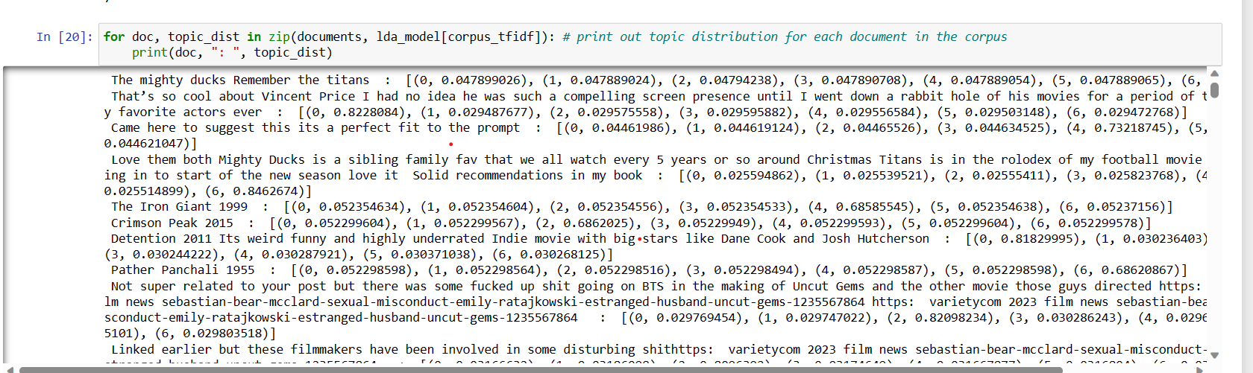
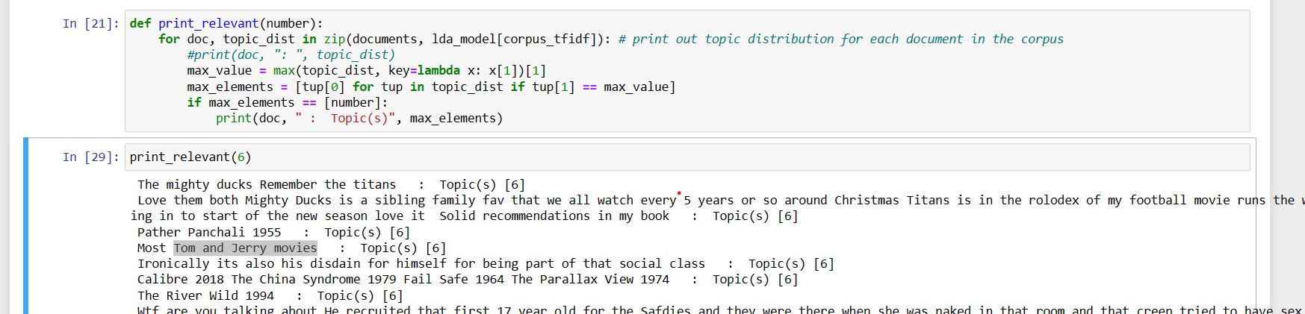
SAMPLE WORKFLOW
This code utilizes probability assignments for each theme based on how well a statement aligns with them. This allows for the classification of movies into seven unique themes, providing tailored recommendations for viewers on what to watch.
When provided with a particular cluster, this code will generate comments and movie titles that belong to that cluster.

Slide 14
Theme | Movie | Prediction
Highly rated films –Theme 1 | Saving Private Ryan, Flushed Away 2006, The Lovely Bones 2009 | Relevant
Hidden gems –Theme 5 | The Iron Giant 1999, Season 1 True Detective | Relevant
Personal recommendations –Theme 6 | Wasteland 2019 | Relevant
Controversial films –Theme 7 | Tom and Jerry movies | Not relevant
Themes 1, 5, and 6 successfully predicted movies based on both the identified themes and the actual genres of the movies. In contrast, the predictions for themes 2, 3, 4, and 7 were either irrelevant or differed from the overall genre or review of the movies.
This highlights that the model is not flawless and requires further refinement to improve its prediction accuracy.

Slide 15
Summary
By the end of the process, we successfully differentiated movie titles and genres and established scores that measure the relationships between different pieces of media. These clusters and scores can be used to assess movie similarity based on their frequency and patterns of mentions in similar conversations. This further facilitated the analysis of comments and movie titles to suggest personalized recommendations for viewers based on their interests.

Slide 16
Conclusion and Future Scope
With the gathered data, we were able to find out:
Identified current popular media
Evaluated perceived value of movies or shows based on user sentiments
Analyzed reasons behind people's interest in certain movies or shows
Suggested recommendations based on similarity and language used.
While the model performed well in predicting certain clusters, such as Themes 1, 5, and 6, it struggled with others, such as Theme 7, where it labeled "Tom and Jerry" as controversial.
A future goal would be to continually update the model with new movies and improve its ability to make accurate predictions.
This approach could also be extended to other types of media, such as music, online videos, and websites.

Slide 17
References
https://en.wikipedia.org/wiki/Bears_%28film%29
https://www.commonsensemedia.org/lists/best-bear-movies-for-kids
https://theappalachianonline.com/paddington-meets-powder-reviewing-cocaine-bear/

Slide 18
Thank you!

